Slide 1
VEHICLE THEFT ANALYSIS
Team Members:
1. SUCHITRA PRIYADARSHINI K
2. SUVETHA SRI V
3. VIJAY VENKATESH R S
Industry Mentor:
Mr. Gokulnath
Faculty Guide:
Mrs. Kamala V
Department of CSE, KGiSL Institute of Technology, Coimbatore

Slide 2
Abstract
In our project “ Vehicle Theft Analysis” we will build a system that helps in analyzing the theft claims and revert with premium changes based on various aspects of theft. We are making use of the technology “Tableau”. Tableau makes visual insurance analytics available to anyone in your insurance company. Complex insurance datasets are no problem for Tableau, making it possible to explore in real time and react to change faster.
Department of CSE, KGiSL Institute of Technology, Coimbatore

Slide 3
Area Introduction-Existing system
EXISTING APPLICATION :
There are applications based on the vehicle theft analysis. In the existing application the analysis performed are not accurate.
There are separate analysis performed for vehicle theft, insurance claims and for fraud analysis.
Region where the vehicle theft are high is not analyzed and visualized.
In the existing system, updation of the data in the dataset are not made in case of theft or fraudlescents.
Department of CSE, KGiSL Institute of Technology, Coimbatore

Slide 4
Proposed System
Advantages over existing methods
Data provided after analysis is accurate.
All data are made available in single analysis
The region where the vehicle theft are high are analyzed and listed.
Whereas in this application current updates are possible.
Future Enhancements
Areas where the false theft cases are filed are analyzed.
Agents under whom the false insurance cases are filed are analyzed.
Minimal time consumption.
Department of CSE, KGiSL Institute of Technology, Coimbatore

Slide 5
Literature Review
DISADVANTAGES OF EXISTING MODEL:
It takes very long time to complete the process
The analysis are approximate but not accurate.
The analyses for theft, insurance claims and fraud analysis are separate.
References
[1] Deborah Lamm Weisel ; William R. Smith ; G. David Garson ; Alexi Pavlichev ; Julie Wartell,
“Motor Vehicle Theft: Crime and Spatial Analysis in a Non-Urban Region(2006) “
[2] Clarke, R.V. & Harris, P.M. (1992). Auto theft and its prevention. In Crime and Justice: A Review of Research, vol. 16, pp.1 –54. Chicago: University of Chicago Press.
[3](PDF) Motor Vehicle Theft: An Analysis of Recovered Vehicles in the Fraser Valley. Available from: https://www.researchgate.net/publication/265194818_Motor_Vehicle_Theft_An_Analysis_of_Recovered_Vehicles_in_the_Fraser_Valley [accessed Feb 26 2019].
Department of CSE, KGiSL Institute of Technology, Coimbatore

Slide 6
Module Split-up
Dataset Module
Updation Module
Data Cleaning Module
Prediction Algorithm Module
Analysis Module
Department of CSE, KGiSL Institute of Technology, Coimbatore

Slide 7
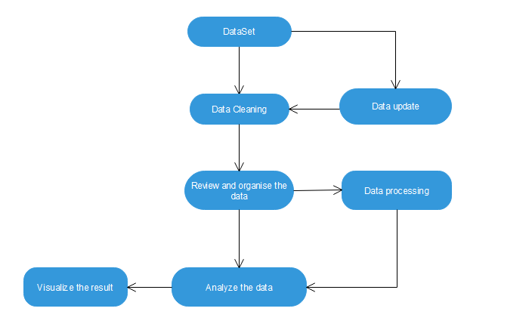
Architectural Diagram

Slide 8
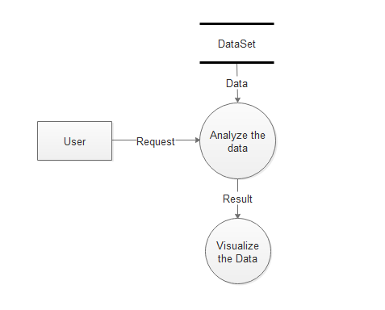
Data Flow Diagram Level 0

Slide 9
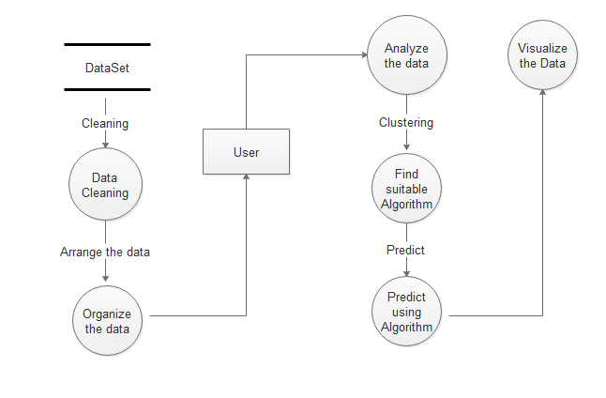
Data Flow Diagram Level 1

Slide 10
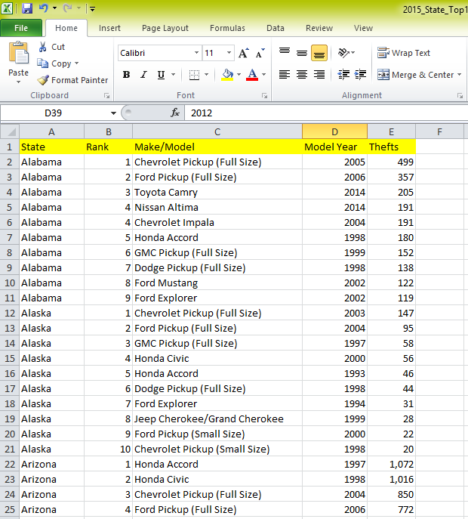
Dataset module

Slide 11
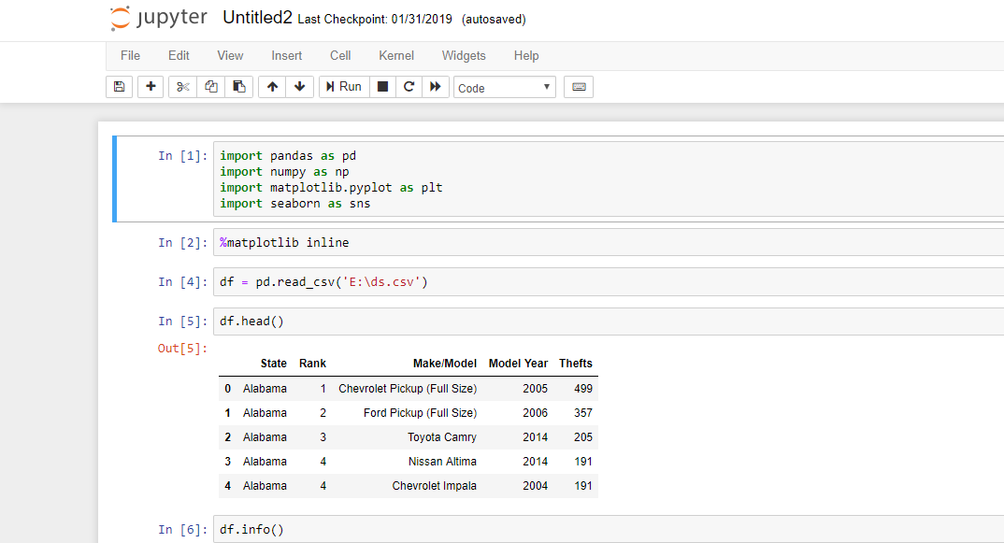
Snapshot

Slide 12
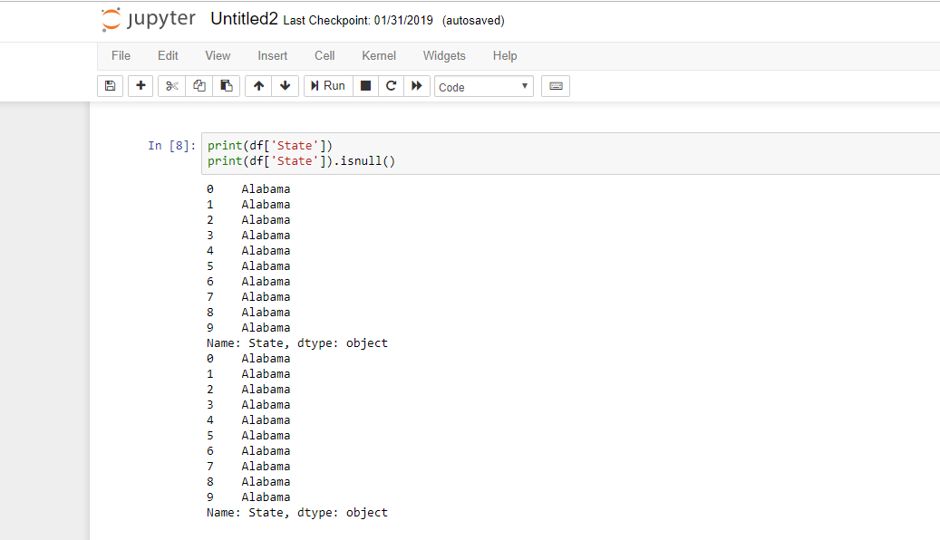

Slide 13
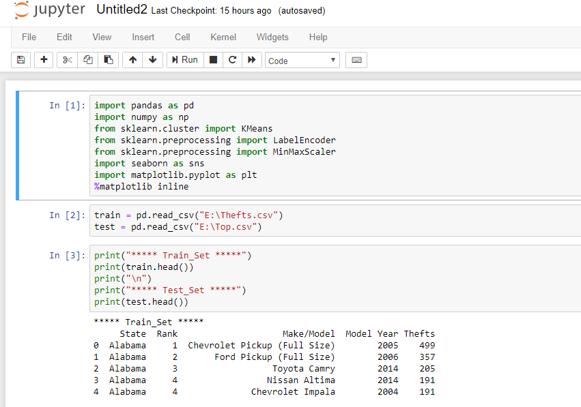
Kmeans Algorithm

Slide 14
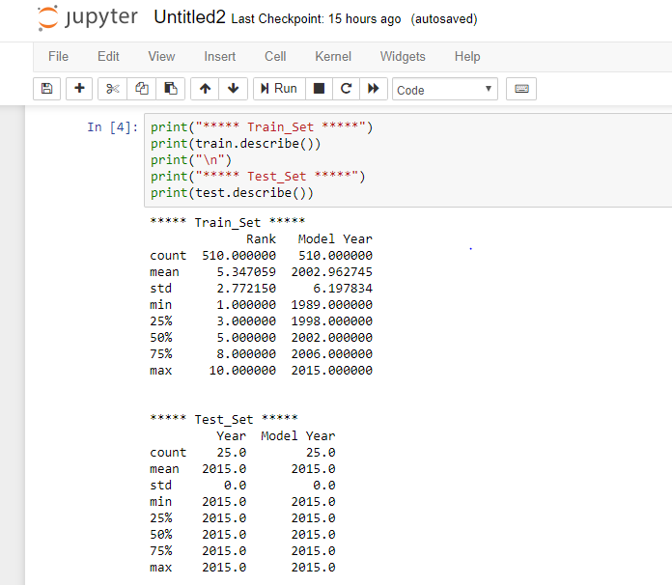

Slide 15
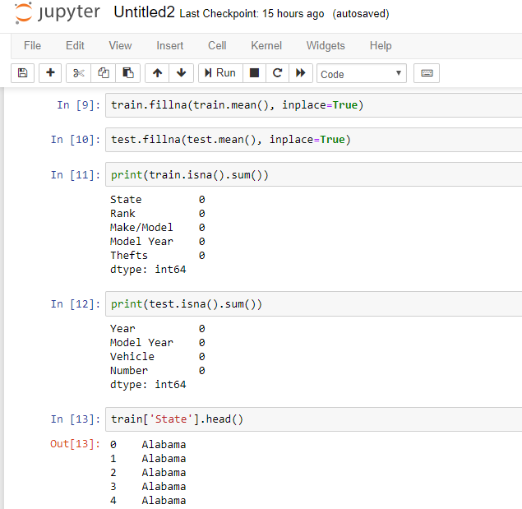

Slide 16
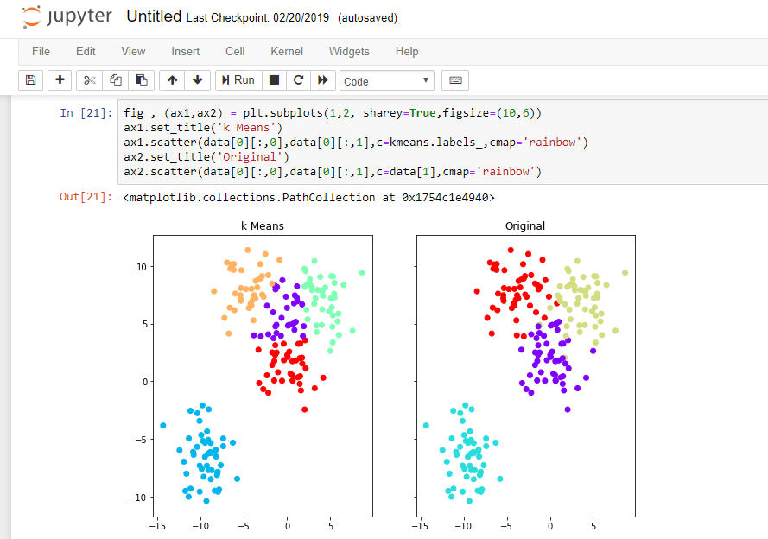

Slide 17
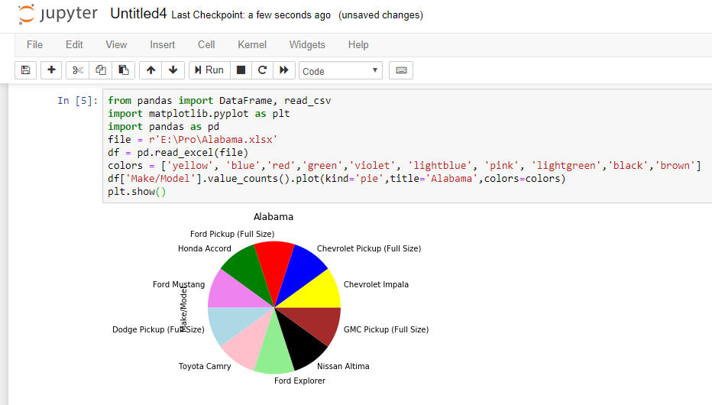
Visualization
Eg:

Slide 18
THANK YOU

